Slide 1

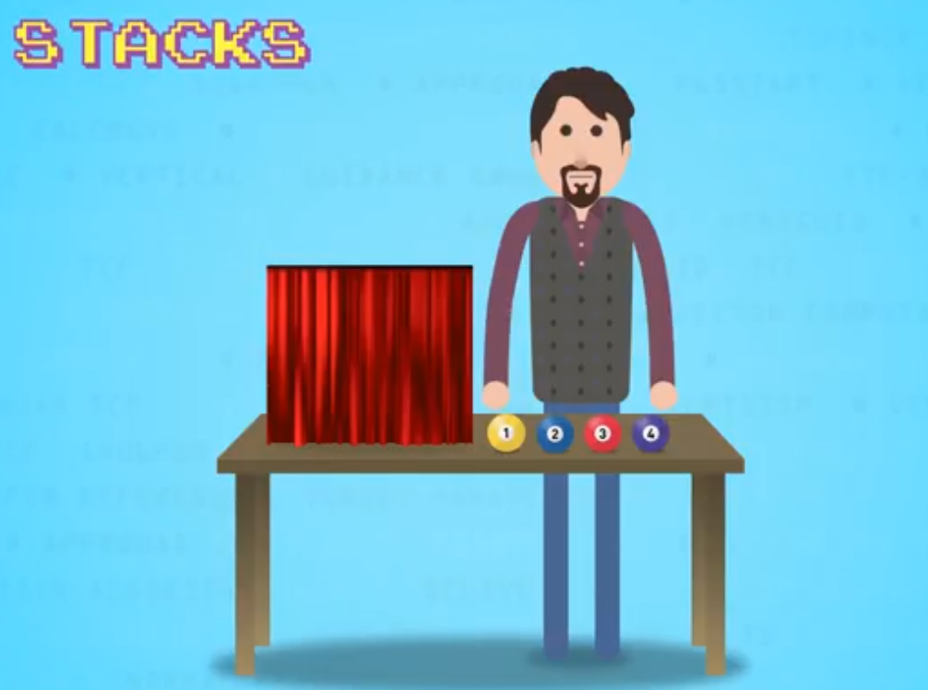


CMPUT 175 Introduction to Foundations of Computing
Stacks
You should view the vignettes:
Abstract data Types
Concept of Encapsulation
Encapsulation, the Gearbox example
Stacks
Post-test

Slide 2
Objectives
In this lecture we will learn about a group of data structures called linear structures.
We will learn about Stacks, Queues and Deques and see how to implement them in python.
We will discuss some example useful applications of these data structures.
Notes:
2

Slide 3
From Formal ADT to Implementation
An ADT is a formal description, not code; independent of any programming language
We will see the description of these structures then their implementation
There are many possible implementations
The code using these implementations doesn’t have to change if the implementation changes as long as the interface remains the same.
Implementation of data structure
Access the data via interface (behaviour) and never directly to data structure implementation
Implementation of behaviour

Slide 4
Linear Structures
A Linear Structure is a non-indexed container object that can grow and shrink one element at a time.
However, it is not specified where the container grows or shrinks.
Linear structures have two ends: Front and Rear (or Top and Bottom) (or Head and Tail)
Linear structures are containers that differ on the location their items are added or removed

Slide 5
Examples of ADT
Lists
Stacks
Queues
Deque
Pile (sorted deque)
Trees
Heaps
Binary search trees
B trees
Maps
Graphs
…
Linear Structures

Slide 6
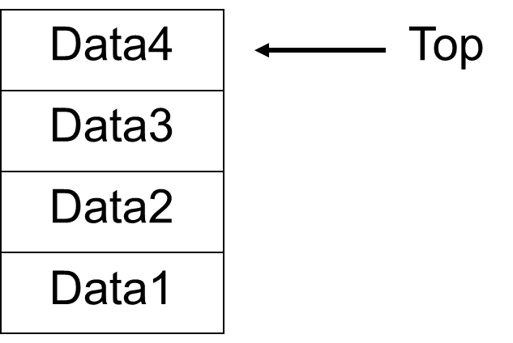
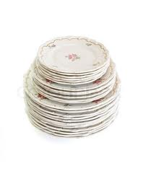


Stacks
Collection with access only to the last element inserted
Last In - First Out (LIFO)
Add element: push
Remove element: pop
top
is empty
check size
New Data
Data5
Push
Pop
Notes:
Useful to solve problems

Slide 7
How useful are Stacks
We will see some examples:
Reversing sequences
Navigating the web
Traversing a maze
Parser matching parenthesis
Infix, Prefix and postfix expressions

Slide 8
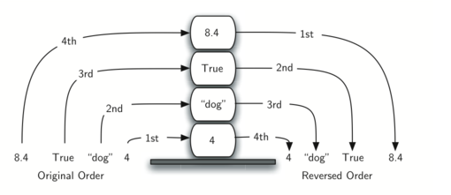
Reversing a sequence
A stack has a reversal property due to LIFO: Last element in is the first out
By pushing elements of a sequence in a stack, popping them afterwards from the stack would reverse the sequence
From textbook
page 84

Slide 9


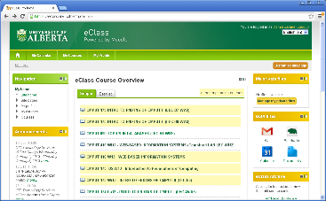
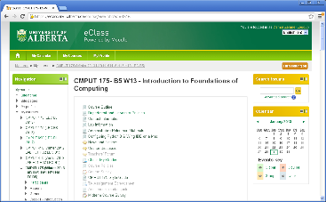
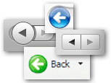
Navigating the web
How does the browser remember the pages I visited when press the “back” button?
Each time a pages is visited the browser “pushes” the URL into a history stack
When the back button is pressed, the browser “pops” a URL from the history stack and displays the corresponding page.
UAlberta
eClass Portal
My eClass
CMPUT 175
My eClass
http://www.ualberta.ca
https://eclass.srv.ualberta.ca/portal/
https://eclass.srv.ualberta.ca/my/
https://eclass.srv.ualberta.ca/course/view.php?id=9516
https://eclass.srv.ualberta.ca/my/
Push
Push
Push
Pop
https://eclass.srv.ualberta.ca/my/
https://eclass.srv.ualberta.ca/portal/
https://eclass.srv.ualberta.ca/portal/
https://eclass.srv.ualberta.ca/portal/
http://www.ualberta.ca
http://www.ualberta.ca
http://www.ualberta.ca
http://www.ualberta.ca
History t₁
History t₂
History t₃
History t₄
History t₅

Slide 10
Maze Algorithm
One common approach to solving search problems is to use a Stack to hold unsearched paths.
Select the start square as the current square.
Repeat as long as the current square is not null and is not the finish square:
“Visit” the square and mark it as visited.
Push one square on the stack for each unvisited legal move from the current square.
Pop the stack into the current square or bind the current square to null if the stack is empty.
If the current square is the goal we are successful, otherwise there is no solution
S
0
5
4
1
2
3
6
7
8
10
11
9
F

Slide 11
Maze Trace
In each position
push all legal moves that were not visited
pop one position and move to it
Fail if stack empty
Success if Final
S
S
S
S
S
S
S
S
S
S
P0
Current position
P1
P2
P3
P4
P5
P6
P7
P8
0
P9
0
0
0
0
0
0
0
0
0
5
5
5
5
5
5
5
5
5
5
4
4
4
4
4
4
4
4
4
4
1
1
1
1
1
1
1
1
1
1
2
2
2
2
2
2
2
2
2
2
3
3
3
3
3
3
3
3
3
3
6
6
6
6
6
6
6
6
6
6
7
7
7
7
7
7
7
7
7
7
8
8
8
8
8
8
8
8
8
8
P2
P3
P4
P5
P7
P8
P9
10
10
10
10
10
10
10
10
10
10
11
11
11
11
11
11
11
11
11
11
9
9
9
9
9
9
9
9
9
9
P1
P6
P6
P6
P6
P6
P10
P10
P10
F
P10
F
F
F
F
F
F
F
F
F
Stack
Success!

Slide 12
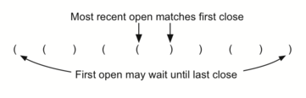
Matching Parenthesis
Push to stack opening parenthesis when encountering an opening parenthesis
Pop from stack when encountering closing parenthesis and check if it corresponds
Correct if all correspond and at the end the stack is empty
([{}]) ([){]} ((({{{}}))) ([(())] ((([]{}())))
From textbook
page 89

Slide 13
Stack Abstract data Type
Stack()
Create a new stack that is empty.
It needs no parameters and returns an empty stack
push(item)
Adds a new item to the top of the stack.
It needs an item and returns nothing
pop()
Remove the top item from the stack
It needs no parameters and returns the item.
The stack is modified.
peek()
Returns the top item from the stack but does not remove it
It needs no parameters and the stack is not modified
isEmpty()
Test to see whether the stack is empty
It needs no parameters and returns a Boolean value
size()
Returns the number of items on the stack
It needs no parameters and returns an integer
isEmpty()
size()
public
private
push()
pop()
peek()

Slide 14
Stack Implementation in Python
How to store the elements in the stack and allow the stack to grow and shrink one element at a time?
Using a python List
We chose the top and bottom of the stack to correspond to some fixed end of the list
Implement each and every method as specified in the Stack ADT (Push, Pop, Peek, isEmpty, Size)
Implement the class and instance creator
Notes:
Stack only has a top, where list has a top and a bottom

Slide 15
Implementation 1
Assuming we chose to have the top of the stack correspond to the beginning of a list.
push
Top
Stack using List
pop
…
class Stack:
def __init__(self):
self.items = []
def push(self, item):
self.items.insert(0,item)
def pop(self):
return self.items.pop(0)
0
n
def peek(self):
return self.items[0]
def isEmpty(self):
return self.items == []
def size(self):
return len(self.items)
Not necessarily the best choice as we shall see
Notes:
Position 0, to push and pop things
Implement it as a class and evey operation is a method

Slide 16
Printing the stack
How to display the stack instance?
The stack is implemented as a list and python knows how to display it.
It is better to define a method to display the stack. Let’s call it show()
def show(self):
print (self.items)
def __str__(self):
return str(self.items)
Converts the object into a string

Slide 17
Let’s test it
s=Stack()
s.show()
print (s.isEmpty())
s.push("bob")
s.show()
print (s.isEmpty())
s.push("eva")
s.push("paul")
s.show()
print (s.size())
item=s.peek()
print (item, "is on top of",s)
item=s.pop()
s.show()
print (item,"was on the stack")
print (s.size())
[]
True
['bob']
False
['paul', 'eva', 'bob']
3
paul is on top of ['paul', 'eva', 'bob']
['eva', 'bob']
paul was on the stack
2
It seems to work as designed but these are very rudimentary tests. More stringent tests done in isolation are always required.

Slide 18
Matching parenthesis
Push to stack opening parenthesis when encountering an opening parenthesis
Pop from stack when encountering closing parenthesis and check if it corresponds
Correct if all correspond and at the end the stack is empty
given parenthesis
create stack s
balanced ← True
index ← 0
while (balanced and index smaller than size of parenthesis) do
if (parenthesis[index] in "([{") push(parenthesis[index])
else
if (stack s is empty) balanced ← False
else
top=pop()
if (top and parenthesis[index] do not match) balanced←False
endif
endif
endif
index ← index +1
endwhile
if (balanced and stack is empty) return True
else return False
endif

Slide 19
Implementing in Python
def parChecker(symbolString):
s = Stack()
balanced = True
index = 0
while index < len(symbolString) and balanced:
symbol = symbolString[index]
if symbol in "([{":
s.push(symbol)
else:
if s.isEmpty():
balanced = False
else:
top = s.pop()
if not matches(top,symbol):
balanced = False
index = index + 1
if balanced and s.isEmpty():
return True
else:
return False
def matches(open,close):
opens = "([{"
closers = ")]}"
return opens.index(open) == closers.index(close)
parenthesis= "([](()){()})"
print(parChecker(parenthesis))
True
parenthesis= "([])[){[)})"
print(parChecker(parenthesis))
False

Slide 20
Let’s time it
We will test parChecker() using our Stack implementation calling parChecker() 10 times then 100 times in 3 repetitions using a long sequence of parenthesis.
t=timeit.Timer("parChecker(p)",setup='from __main__ import parChecker;p="({[([{({[]})}])]})(){}[]{{{[[[((()))]]]}}}("')
print ("10 times: %17.14f milliseconds"%(t.timeit(number=10)))
print(t.repeat(repeat=3,number=100),"milliseconds (3x100 times)")
10 times: 0.00111746616541 milliseconds
[0.010608966165413534, 0.010612721804511277, 0.010742304511278191] milliseconds (3x100 times)

Slide 21
Implementation 2
Now we chose to have the top of the stack correspond to the end of a list.
Stack using List
Avoids shifting elements when a new one is added or removed
Top
push
…
pop
class Stack:
def __init__(self):
self.items = []
def push(self, item):
self.items.append(item)
def pop(self):
return self.items.pop()
0
n
def peek(self):
return self.items[len(self.items)-1]
def isEmpty(self):
return self.items == []
def size(self):
return len(self.items)

Slide 22
Comparison
push
Top
Top
push
pop
…
…
pop
0
n
0
n
def __init__(self):
self.items = []
def push(self, item):
self.items.insert(0,item)
def pop(self):
return self.items.pop(0)
def peek(self):
return self.items[0]
def isEmpty(self):
return self.items == []
def size(self):
return len(self.items)
def __init__(self):
self.items = []
def push(self, item):
self.items.append(item)
def pop(self):
return self.items.pop()
def peek(self):
return self.items[len(self.items)-1]
def isEmpty(self):
return self.items == []
def size(self):
return len(self.items)
Implementation 1
Implementation 2

Slide 23
Let’s test implementation 2
s=Stack()
s.show()
print (s.isEmpty())
s.push("bob")
s.show()
print (s.isEmpty())
s.push("eva")
s.push("paul")
s.show()
print (s.size())
item=s.peek()
print (item, "is on top of",s)
item=s.pop()
s.show()
print (item,"was on the stack")
print (s.size())
[]
True
['bob']
False
['bob', 'eva', 'paul']
3
paul is on top of ['bob', 'eva', 'paul']
['bob', 'eva']
paul was on the stack
2
It seems to work like implementation 1.

Slide 24
Time implementation2
We replace the 1st Stack class implementation with the second one and rerun parCheck using our new Stack implementation like we did before
t=timeit.Timer("parChecker(p)",setup='from __main__ import parChecker;p="({[([{({[]})}])]})(){}[]{{{[[[((()))]]]}}}("')
print ("10 times: %17.14f milliseconds"%(t.timeit(number=10)))
print(t.repeat(repeat=3,number=100),"milliseconds (3x100 times)")
10 times: 0.00090155639098 milliseconds
[0.00903445864661654, 0.009115150375939851, 0.00897549248120301] milliseconds (3x100 times)
Remember, with previous implementation
10 times: 0.00111746616541 milliseconds
[0.010608966165413534, 0.010612721804511277, 0.010742304511278191] milliseconds (3x100 times)

Slide 25
Lesson to learn
Thanks to the encapsulation of the Stack implementation and the clear interface we were able to swap the implementation of Stak with another one without having to change or update the program [parChecker()] that uses it.
Stack
Stack
isEmpty()
size()
isEmpty()
size()
parChecker()
public
private
private
push()
pop()
push()
pop()
Old implementation
peek()
peek()

Slide 26
Arithmetic Expressions
Arithmetic expression we have series of operators and operands
Operators are +, -, / * and ^
Each Operators, except ^, has two operands
In an expression we can have many operators
Operators have different priorities (precedence)
^ has highest precedence
* and / have higher precedence than + and -

Slide 27
Infix, Prefix and Postfix Expressions
Arithmetic expression: X * Y + Z
Infix: Operator appears between variables – eg. X * Y
Because of operator precedence rules
X * Y + Z is equivalent to (X * Y) + Z
Parenthesis remove ambiguity
X * Y + Z is different from X * (Y + Z)
How do we remover ambiguity to the computer? Should we have fully parenthesized expressions?

Slide 28
Infix, Prefix and Postfix
Infix: X * Y → operator between operands
Prefix: * X Y → operators before operands
Postfix: X Y * → operators after operands
With Prefix and Postfix notations, parenthesis are not required to disambiguate expressions.
Infix Expression
X + Y * Z
(X + Y) * Z
(X + Y) * Z + V
Prefix Expression
+ X * Y Z
*+X Y Z
+*+ X Y Z V
Postfix Expression
X Y Z * +
X Y+ Z *
X Y + Z * V +

Slide 29


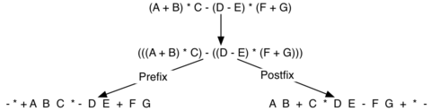
Conversion from Infix to Pre and Postfix expressions
Transform to fully parenthesized then convert
Operands don’t move. Only operators change position
Moving Operators to the Right for Postfix Notation
A B C * +
Moving Operators to the Left for Prefix Notation
+ A * B C
From textbook
pages 98-99
Converting a Complex Expression to Prefix and Postfix Notations

Slide 30
Advantage of Postfix notation
Also called Reverse Polish notation
Invented in 1920 by Polish logician Jan Łukasiewicz
It is unambiguous and does not require parenthesis or brackets
Can be used for arithmetic, logic and algebra
We will see how to convert an infix expression to a postfix expression using a Stack. Then we will evaluate a postfix expression using a stack to find out the value of the expression.

Slide 31
General Infix to Postfix Conversion using Stack
When we converted A+B*C we obtained ABC*+; the sequence of operands ABC didn’t change but the sequence of operators got reversed from + * to * +
Moving Operators to the Right for Postfix Notation
A B C * +
This observation hints on the use of a Stack to do this conversion algorithmically.
Assuming the infix expression to convert is a string in which each character being either an operator, an operand or parenthesis all separated by a space, we can split these into a list and analyze and convert the expression from the list going left to right one single element (called token) at a time.

Slide 32
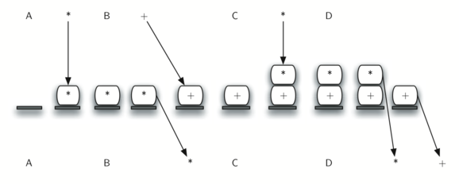
General Infix to Postfix Conversion using Stack
If token is an operand, append it to the end of an output list
If the token is an opening parenthesis, push it to the stack
If the token is a closing parenthesis, pop elements from the stack until the corresponding opening parenthesis and append each operator to the end of the output list.
If the token is an operator, check the top of the stack, as long as there are operators with higher precedence than the token, pop them out and append them to the output list, then push the token to the stack.
At the end empty stack into the output
Input string
“A * B + C * D”
Input list
[A,*,B,+,C,*,D]
Stack states
Output list
[A,B,*,C,D,*,+]

Slide 33
Infix to Postfix in Python
def infixToPostfix(infixexpr):
alphaOperand="ABCDEFGHIJKLMNOPQRSTUVWXYZ"
digitOperand="0123456789"
prec = {}
prec["*"] = 3
prec["/"] = 3
prec["+"] = 2
prec["-"] = 2
prec["("] = 1
opStack = Stack()
postfixList = []
tokenList = infixexpr.split()
for token in tokenList:
if token in alphaOperand or token in digitOperand:
postfixList.append(token)
elif token == '(':
opStack.push(token)
elif token == ')':
topToken = opStack.pop()
while topToken != '(':
postfixList.append(topToken)
topToken = opStack.pop()
else:
while (not opStack.isEmpty()) and \
(prec[opStack.peek()] >= prec[token]):
postfixList.append(opStack.pop())
opStack.push(token)
while not opStack.isEmpty():
postfixList.append(opStack.pop())
return " ".join(postfixList)
Traverse input and for each token
if operand, append to output
if “(“ push to stack
if “)”, pop and output until “(“
If operator pop all operators with more precedence and append to output, then push operator
At the end empty stack into output

Slide 34
More complicated example
Token | Action | Output | Operator Stack | Notes
3 | Add token to output | 3
+ | Push token to stack | 3 | +
4 | Add token to output | 3 4 | +
* | Push token to stack | 3 4 | * + | * has higher precedence than +
2 | Add token to output | 3 4 2 | * +
/ | Pop stack to output | 3 4 2 * | + | / and * have same precedence
 | Push token to stack | 3 4 2 * | / + | / has higher precedence than +
( | Push token to stack | 3 4 2 * | ( / +
5 | Add token to output | 3 4 2 * 5 | ( / +
− | Push token to stack | 3 4 2 * 5 | − ( / +
1 | Add token to output | 3 4 2 * 5 1 | − ( / +
) | Pop stack to output | 3 4 2 * 5 1 − | ( / + | Repeated until "(" found
 | Pop stack | 3 4 2 * 5 1 − | / + | Discard matching parenthesis
+ | Pop / from stack to output | 3 4 2 * 5 1 − / | + | + has lower precedence than /
 | Push token to stack | 3 4 2 * 5 1 − / + | + | and equal precedence to +
( | Push token to stack | 3 4 2 * 5 1 − / + | (+ +
2 | Add token to output | 3 4 2 * 5 1 − / + 2 | (+
+ | Push token to stack | 3 4 2 * 5 1 − / + 2 | + (+
3 | Add token to output | 3 4 2 * 5 1 − / + 2 3 | + (+
) | Pop stack to output | 3 4 2 * 5 1 − / + 2 3 + | (+
 |  | 3 4 2 * 5 1 − / + 2 3 + | + | Repeated until "(" found
end | Pop entire stack to output | 3 4 2 * 5 1 − / + 2 3 + +
Input:
3 + 4 * 2 / ( 5 - 1 ) + ( 2 + 3 )
operator | precedence
* | 3
/ | 3
+ | 2
- | 2
output:
3 4 2 * 5 1 - / + 2 3 + +
Evaluation
3 + 4 * 2 / ( 5 - 1 ) + ( 2 + 3 )
3 + 4 * 2 / 4 + 5
3 + 8 / 4 + 5
3 + 2 + 5 = 10
3 4 2 * 5 1 - / + 2 3 + +
3 8 5 1 - / + 2 3 + +
3 8 4 / + 2 3 + +
3 2 + 2 3 + +
5 2 3 + +
5 5 +
10

Slide 35
Postfix Evaluation using Stack
In postfix notation, each operator applies to the previous two operands
We should store the operands in a stack
Traverse the expression from left to right and push operands on the stack and each time we encounter and operator, we pop two operands, apply the operator on them and push the result on the stack. The final result is on top of the stack.

Slide 36
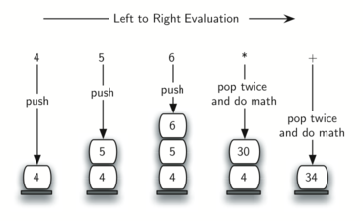
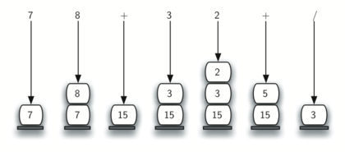
Examples of Evaluation

Slide 37
Python Implementation
from pythonds.basic.stack import Stack
def postfixEval(postfixExpr):
operandStack = Stack()
tokenList = postfixExpr.split()
for token in tokenList:
if token in "0123456789":
operandStack.push(int(token))
else:
operand2 = operandStack.pop()
operand1 = operandStack.pop()
result = doMath(token,operand1,operand2)
operandStack.push(result)
return operandStack.pop()
def doMath(op, op1, op2):
if op == "*":
return op1 * op2
elif op == "/":
return op1 / op2
elif op == "+":
return op1 + op2
else:
return op1 - op2
print(postfixEval("3 4 2 * 5 1 - / + 2 3 + +"))
10

